Slide 2
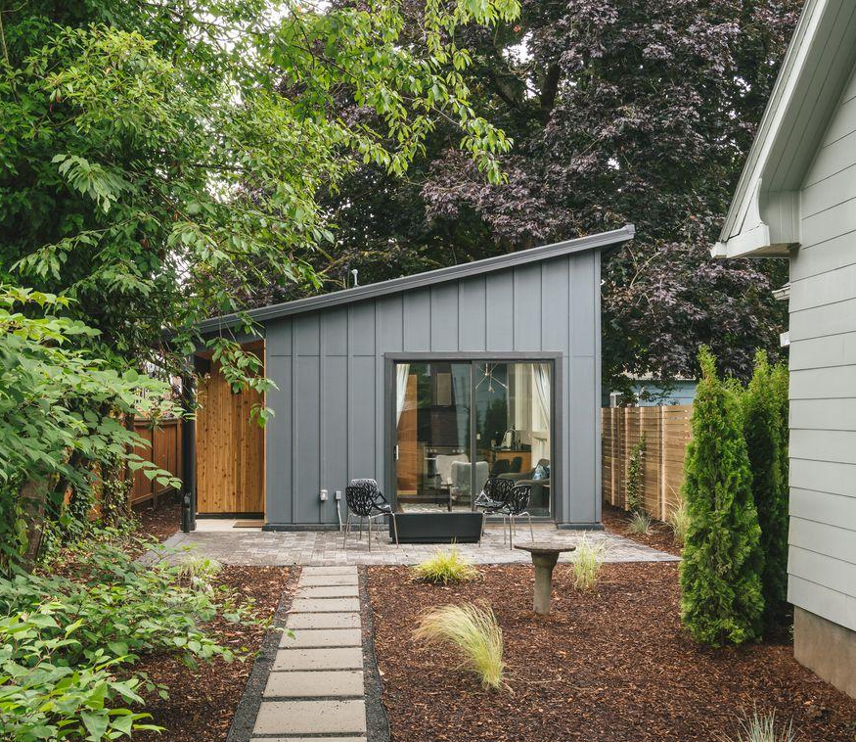
The innovative Affordable ADU Loan Program generates a new accessory dwelling unit that is affordable to build and affordable to rent by offering a discounted capital loan and leasing support to Orange County homeowners.
– ADUs provide 10 years of stable, affordable housing for very low-income families and RHNA credits for local jurisdictions
– Loans are low-interest, deferred for up to 20 years, and partially forgivable
– Fully recycled into new loans upon repayment
– A regional solution for a regional challenge

Slide 3
What is an ADU?
An Accessory Dwelling Unit (ADU) is a smaller, secondary residence on a lot that already has a home, or has one under construction.
ADUs serve various needs for homeowners, including housing elderly or young adult family members and caregivers or increasing household income as a rental outside of the family.

Slide 4
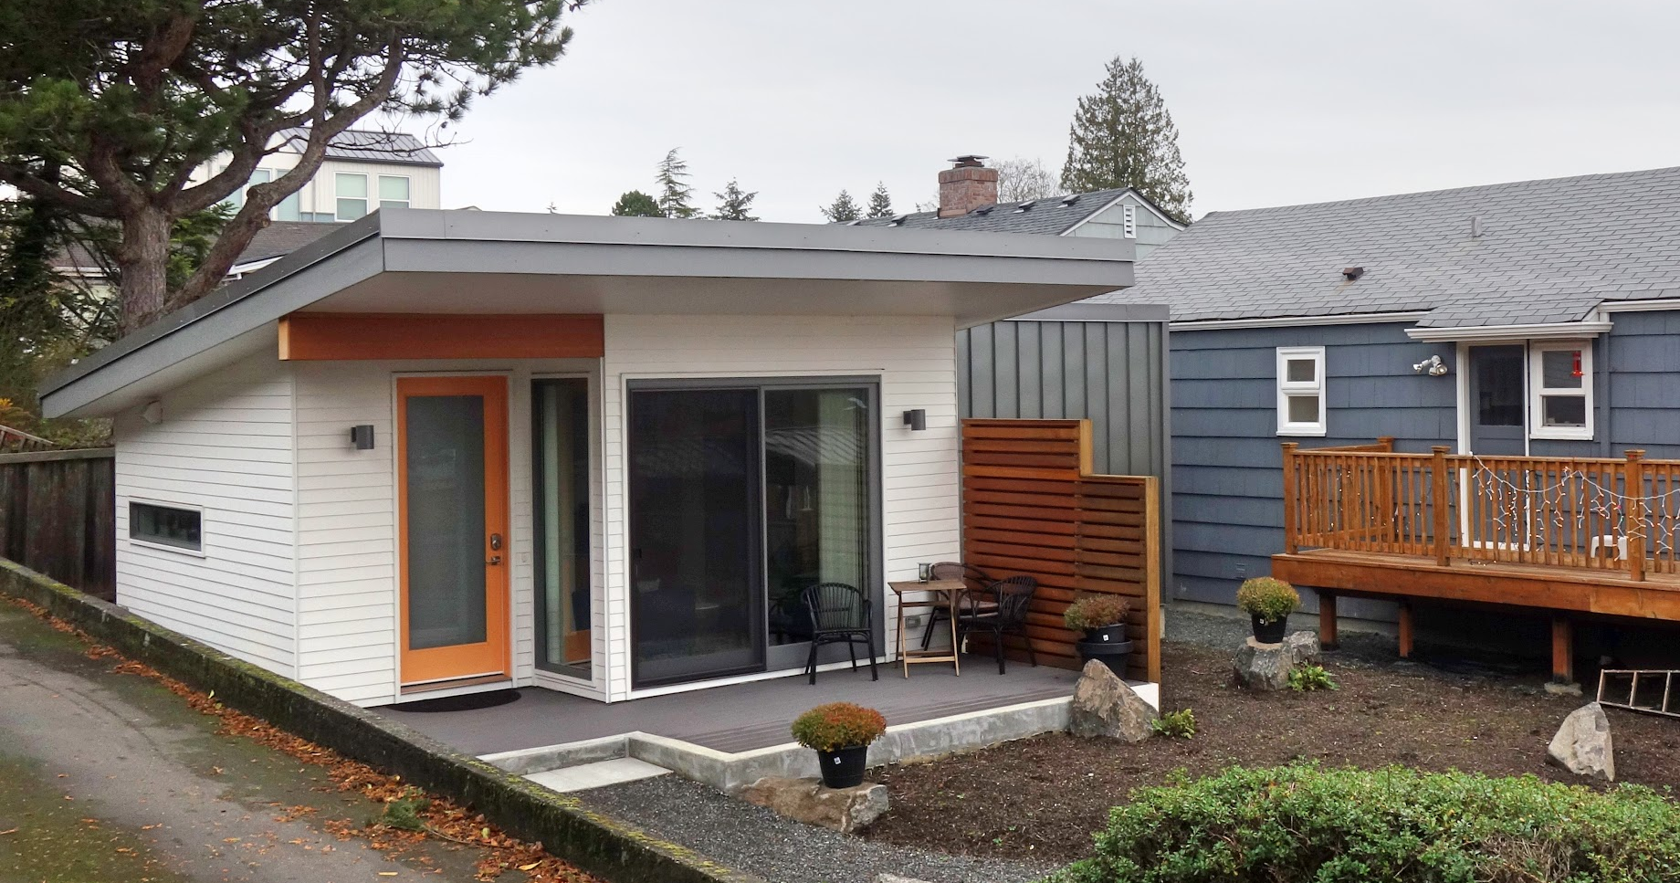
Benefits for Homeowners
– $100,000 deferred loan for 20 years
– $5,000 fully forgivable loan for disability-accessible ADUs*
– $400 forgiveness per month with a qualified tenant
– 0-3% interest with a qualified tenant
– Option to rent to family or students
– Professional property management assistance for finding and selecting a tenant
To be eligible, homeowners must reside in the principal home in a Trust member city/county, be in the process of building an ADU (but not completed), have secured adequate funding for the remaining construction costs, not exceed maximum debt ratios, and work with a licensed contractor.

Slide 5
Who is an “eligible tenant?”
Anyone whose income is less than 50% of the Area Median Income (AMI) for Orange County is an eligible renter

Slide 6
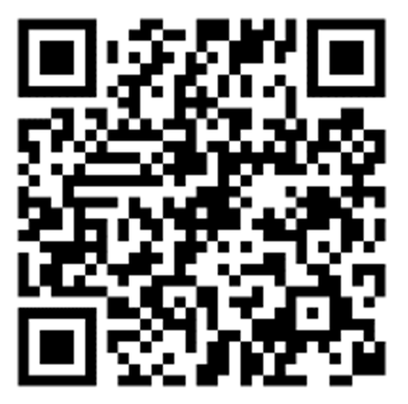
How to Apply
Application Requirements
Sign up for the Interest Standby List on the Trust’s website
Wait for an invitation to complete an application
Complete the application
Applications will be reviewed, and loan commitment letters will be issued on a first-come, first-served basis.
When you receive the invitation, you should respond as soon as you can with the required information
– Feasibility Assessment of the ADU and site
– Recent loan statements on any debt on the property
– Preliminary cost estimate from a builder
– Proof of other funding
– Preliminary Design plan
– Property appraisal, depending on the debt-to-value of your home

